Slide 1
Examining the Accuracy vs. Consistency Tradeoff of Classifier Models
Team PlanetR - Sarita Inguava, Sofia Kenny, Greg Murray, Kiran Singh, Srinivasan Vasudevan

Slide 2
Agenda
Objective
Methodology
Analysis & Insights
Future Scope

Slide 3

“...the best response to the housing bubble would have been regulatory, not monetary.”
Ben Bernanke, Ex-Chairman of the Federal Reserve Board, 2010
Notes:
Financial crisis in 2008
Financial regulators need to ensure accuracy and consistency to ensure fairness
Give regulators another tool in the form of consistency

Slide 4
Objective
Problem: Classifiers are evaluated based on Accuracy (Confusion Matrix). There is no measure to define the consistency of a classifier.
Solution:
Define “Consistency” and examine the Consistency vs. Accuracy tradeoff.
Why is it important?
Lending Regulators can choose a model which has the best accuracy and consistency score in order to assess lenders fairly and accurately.
Notes:
Why is it Important ?
Many domains need a consistent methodology execution in their workflow. For example in, Home Mortgage Approval System, Lenders should demonstrate they implement consistent methodology in their execution that lead to either approval or denial decisions. In this project we used Home Mortgage Data 2014 to come up with Accuracy and Consistency scores for few classifier models.
Financial Regulators can choose a model which has the best accuracy and consistency score to do their analysis to find out non-compliant lenders.

Slide 5
Data Summary
U.S. Home Mortgage Data from 2014
11.7 million loan records reported by 7,062 financial institutions
Applications for home purchase, for home improvement, and for refinancing.
Accuracy data = all loans
Consistency data = calculated from loans of top 20 financial institutions

Slide 6
Definitions
Accuracy from confusion matrix
Consistency = Average of standard deviation of loan approval predictions across lenders.
Sample of 20 top lenders
Train the model with one lender, test on the other 19 lenders
Repeat for all lenders
Measure standard deviation of loan approval predictions across each lenders
From the average standard deviation, derive a “consistency score”

Slide 7
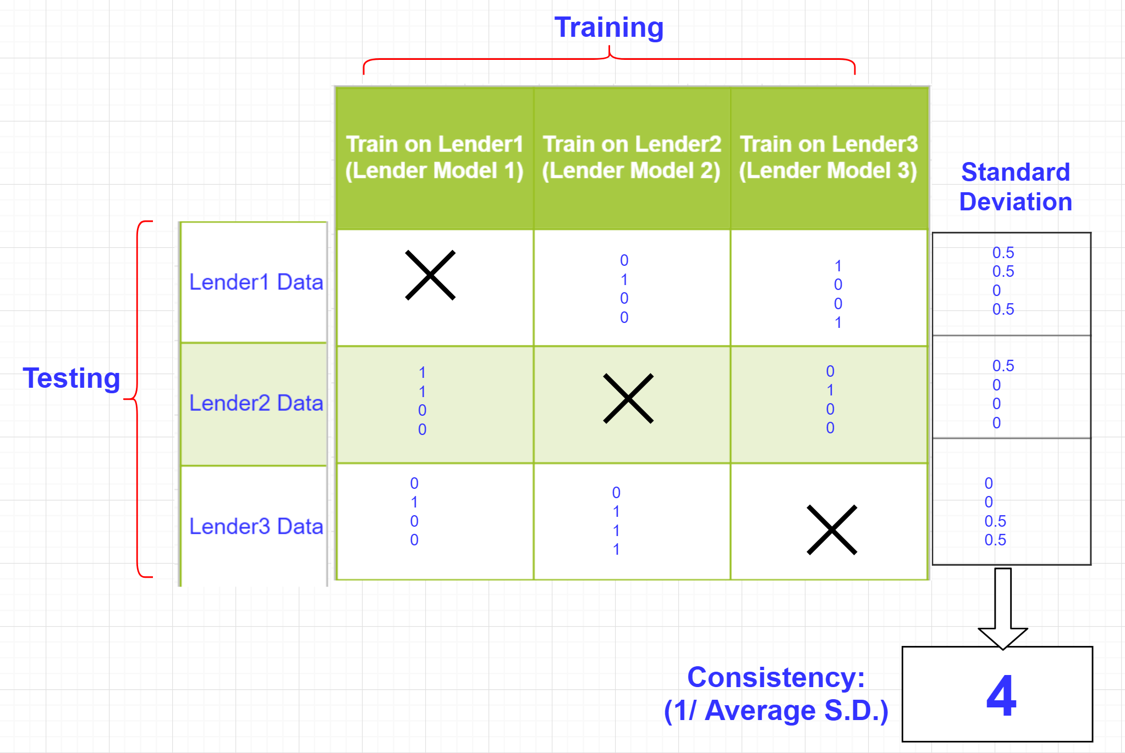
Logit Example:

Slide 8
Key Model Features
Approved (binary)= Applicant income + Demographics + Location + Loan Specifics
Models considered: LDA, SVM, C4.5, Logit, naive-Bayes

Slide 9
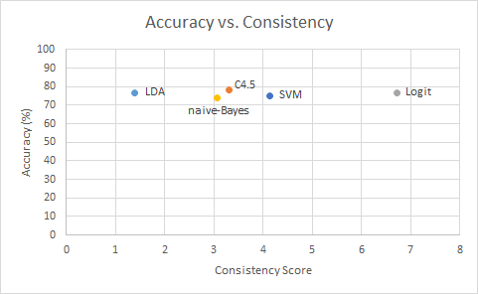

Slide 10
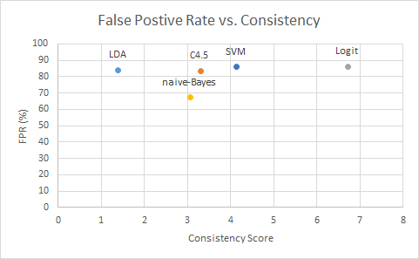

Slide 11
Insights
Accuracy is similar across all models
The data had significant omitted variables: credit score, debt, etc.
Accuracy is marginally improved vs. that of a naive model (75%)
Consistency winner: Logit

Slide 12
Future Scope
Expand the scope
Test more predictive algorithms
More robust data and test different domains (consult domain experts)
Infer the underlying mechanisms behind models which impact Accuracy & Consistency
Explore an application regarding mergers & acquisitions; lenders may be interested in other lenders with similar approval or rejection patterns.

Slide 13
Questions?

Slide 14
Appendix

Slide 15
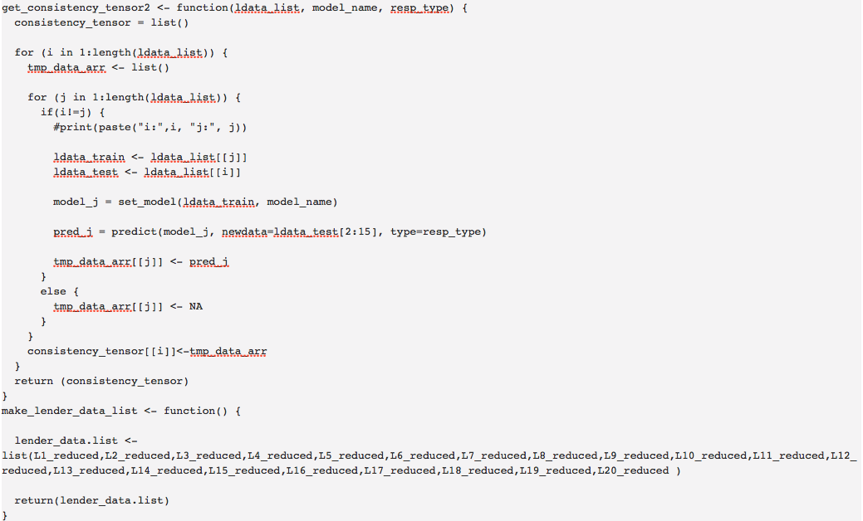

Slide 16
